Slide 1
Intelligent Recommender System : Project Anime Recommendation system
Mohamed Attia – 20100211

Slide 2
Outline
Introduction
Problem Statements
Goals
Solution Statements
Data Understanding
Exploratory data analysis
Data preparation
content -based Filtering
Collaborative Filtering
Hybrid Model
Knowledge-Based Recommendations
Conclusion
References

Slide 3
Introduction
The animation market has grown significantly, with more than 200 pieces of animation annually, reaching about 1.8 trillion yen. The popularity of anime, such as "Hajj", affected regional industries and local governments. About 30 % of the industry market is shared through external sales, and animation is the largest share in the value of exporting the contents of Japanese broadcasting. To address this, the animation work recommendation is proposed called "Anireco". This system aims to easily help users find animation corresponding to their preferences, identify the animation items they prefer, and enhance their interest in relevant content. Anime has become a common choice for the masses, as databases and databases provide access to various types of anime and different eras. To address this, an effective recommendation system must be developed to provide relevant and related content for anime lovers, allowing them to easily choose anime that corresponds to their preferences and preferences.

Slide 4
Problem Statements
Based on the background above, here are the limits of the problems that can be solved with this project:
How can you develop an anime recommendation system that can be modified for individual anime lovers?
What is the most effective model in submitting anime lovers to choose the right anime?
What is the process of making the recommendation system in submitting recommendations for anime lovers to choose anime according to their preferences?

Slide 5
Goals
The purpose of this project is:
The creation of anime recommendation system aims to provide comfort for anime lovers to find anime addresses that are appropriate to their preferences.
The performance of the various models in the anime recommendation system is compared to finding the most effective.
Explain the principle of work for the model algorithms used in the recommendation system to provide anime recommendations for anime lovers based on data such as previous preferences, assessments or other information.

Slide 6
Solution Statements
For features, it is implemented by a single -variable analysis that aims to verify the distribution of a specific feature in the data set. This approach includes the use of data visualization techniques, such as Barplot, to provide information about the specific features.
Modeling using many algorithms such as filtering content and cooperative filter to reach the required solution.
To find out the performance of the model, check the performance using evaluation measures such as accuracy, the similarity of the perfection pocket, and the average root error (RMSE).

Slide 7
Data Understanding
Understanding data is the initial stage of the project to understand the data they have. So that the contents of the data set are easier to understand, do the data download process first. Do not forget to import all the necessary libraries in making models.
The data collection used is anime data that arises from myanimelist.net on the KAGGLE page. The data collection contains two CSV files, which are anime and classification files. Anime.csv file consists of 7 columns and 12294 rows, while the Rating.csv file consists of 3 columns and 7813737 rows.
Printing unique data in the column in each data group

Slide 8
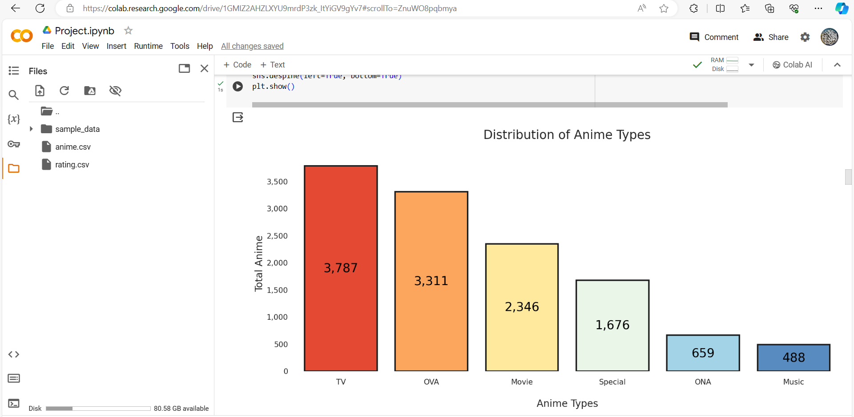
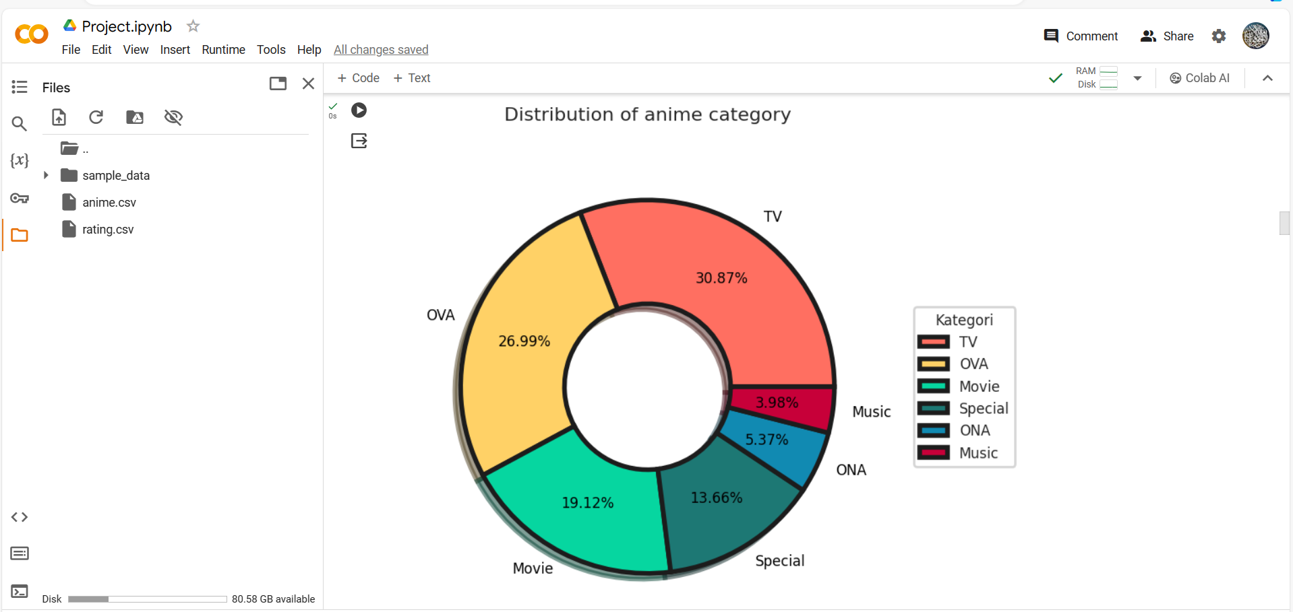
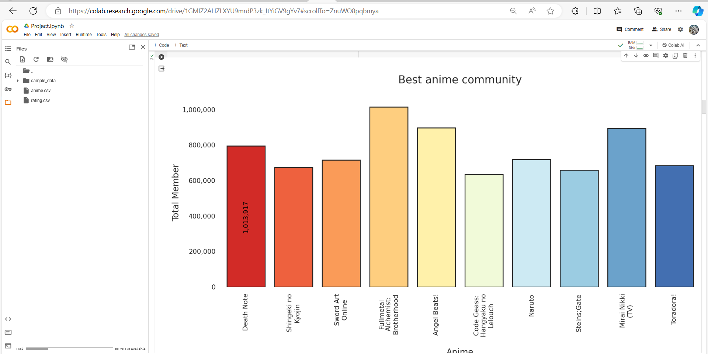
Exploratory data analysis
To understand more data, a single variable analysis and data visualization have been performed
Note Death Note has the highest member of society, followed by Shingeki No Kyojin and Sword Art Online

Slide 9
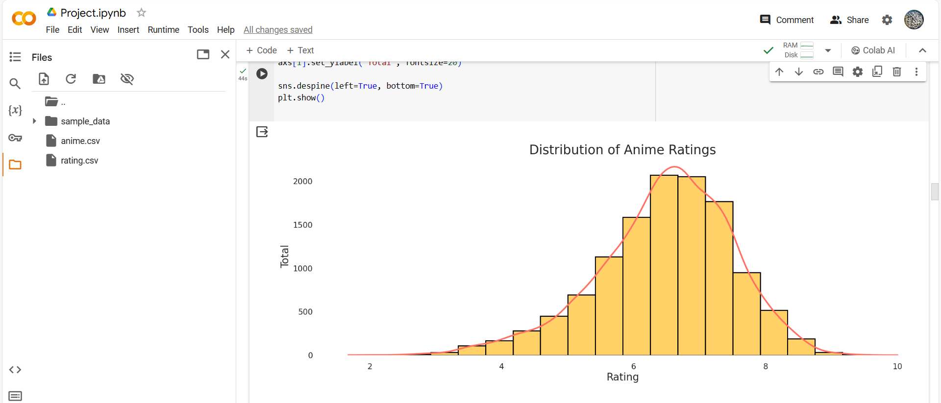
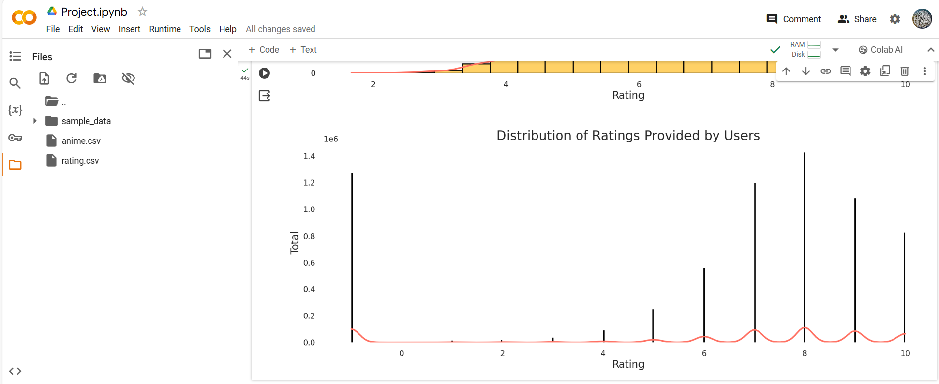
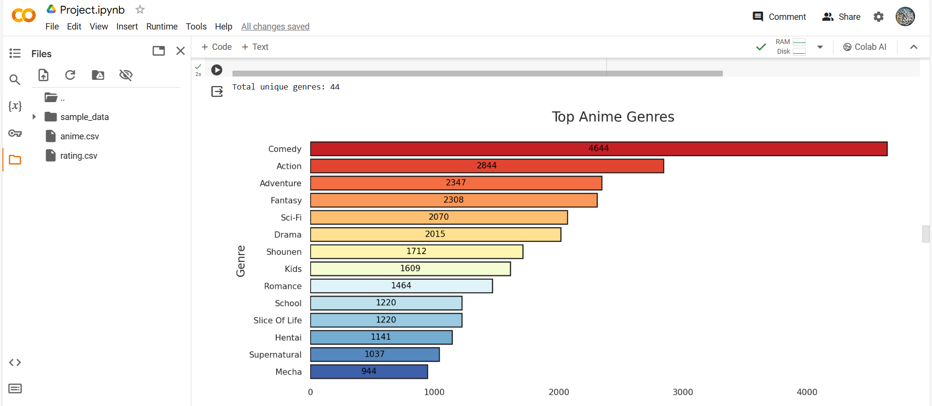
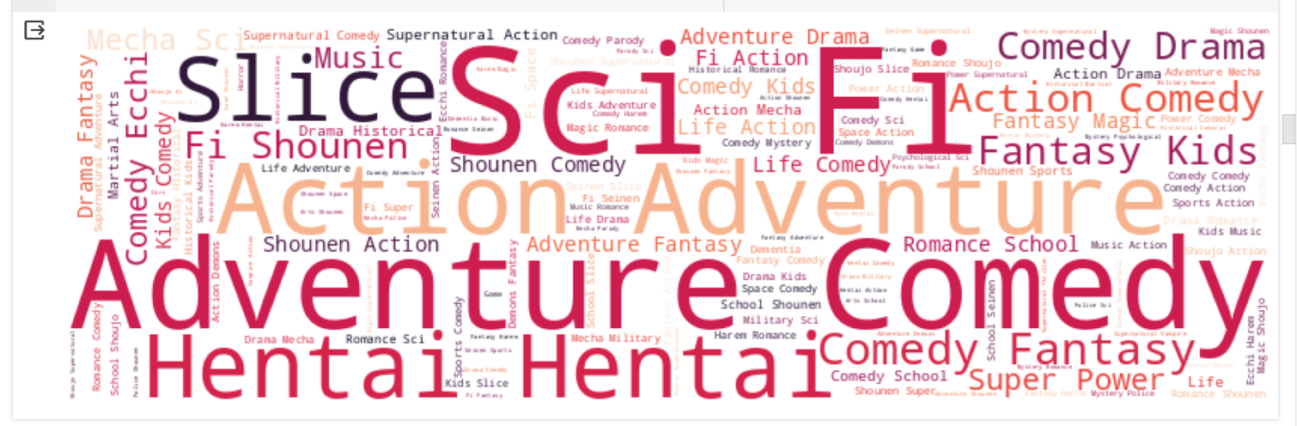
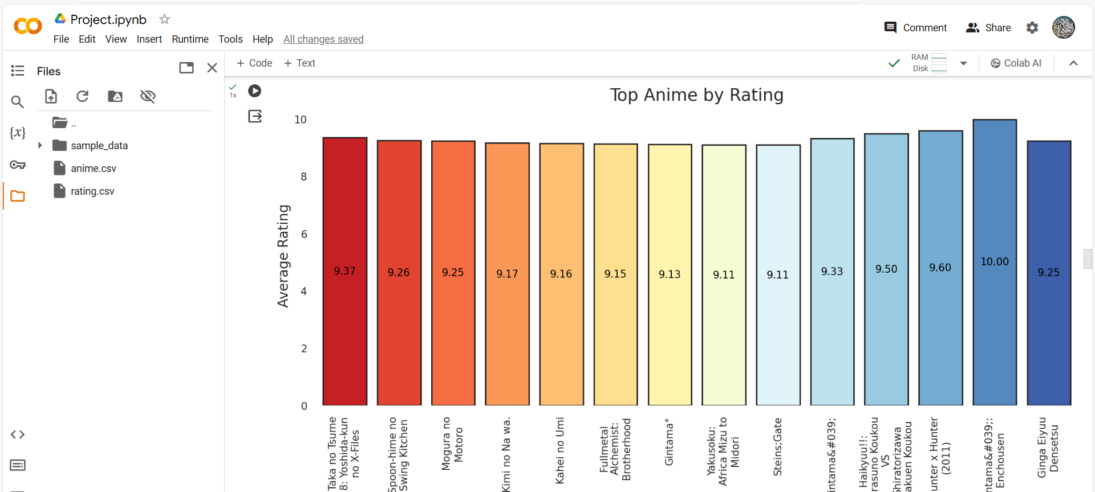
There are 3430 anime or 33.54 % of the total anime broadcast on TV. A total of 2219 anime or 21.7 % of the total anime broadcast as a film. There are 1936 anime or 18.93 % of the total anime broadcast as OVA. This is more than ONA, which includes 633 anime or 6.19 % of the total anime. The anime classifications range from 5.5 to 8.0, while user classifications fall between 6.0 and 10.0, with a distribution mode of about 8.0, with user -1 classifications being ignored. Overall, this code creates and displays a word cloud visualization of the text data stored in the "genre" column of the DataFrame `top_anime`. The word cloud visually represents the frequency of different genres in the anime dataset.

Slide 10
Data preparation
The comedy category has 39 species with the highest movement and adventure. To ensure the model's predictions are trustworthy, it is essential to apply the "garbage in, garbage out" principle. The quality of the training data is crucial for the final model. Additionally, the data set must be cleaned to improve organization and prepare it for further processing.
There is no missing value on the data set. Delete user categories that have a value -1 verification of repeated data on "DF_Anime. There is no duplicate data on" DF_Anime "on the data collection. Clean the text of the animation address

Slide 11
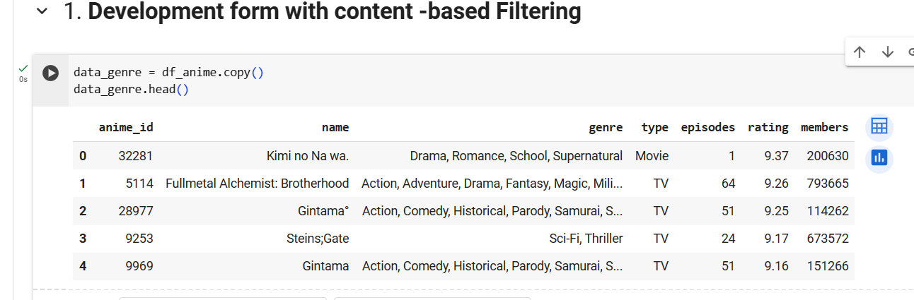
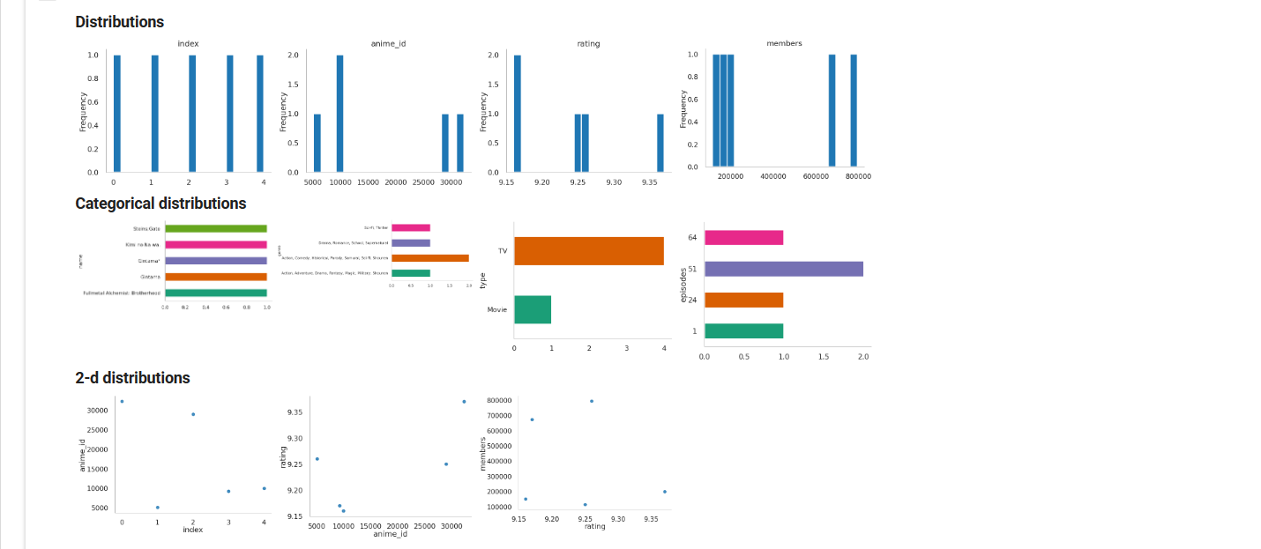
content -based Filtering
Content-based filtering is a technique used in a recommendation system to make recommendations based on the characteristics of existing items or their content. In an anime recommendation system, this algorithm analyzes the attributes of each anime, such as genre, to make recommendations to users. The algorithm extracts features from selected categories using TF-IDF Vectorizer and performs the fit and transform to a matrix. The output shows a high correlation between anime names and specific categories.
To build a recommendation system, the degree of similarity between anime names is calculated using the cosine similarity model. The model produces a similarity matrix in array form, which can be viewed in 5 sample columns and rows. The model determines the degree of similarity in 10,228 anime and displays recommendations for N similar animations.
To generate top N animation recommendations for users, the highest k values are taken from the similarity data and entered into the nearest variable. The code then applies the code to find recommendations similar to the user's animation.

Slide 12
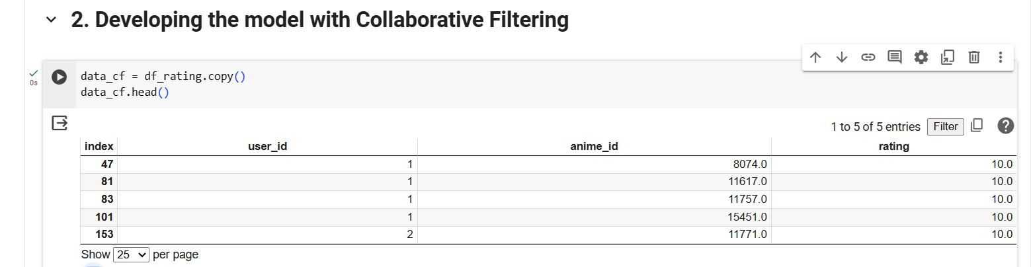
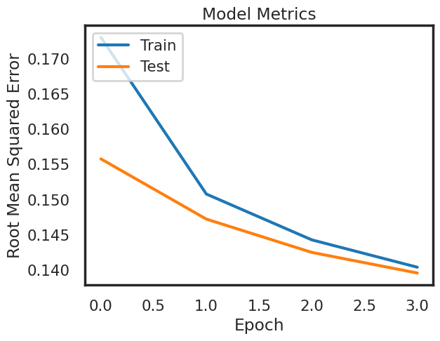
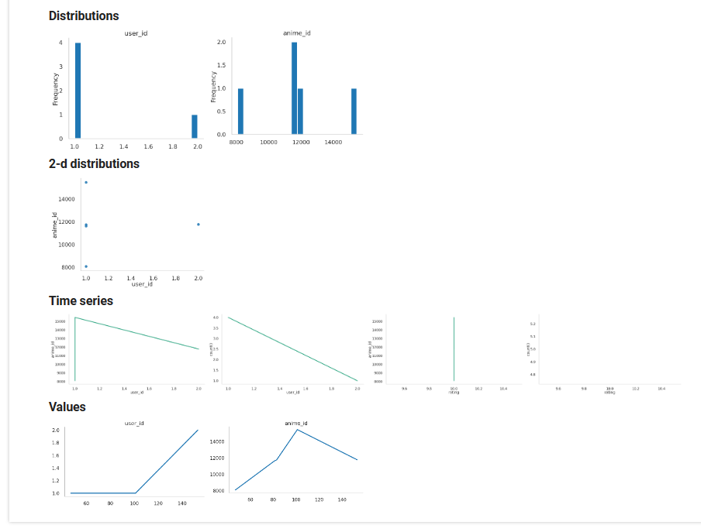
Collaborative Filtering
Collaborative filtering is a method in recommender systems that analyzes user behavior and preferences to make recommendations. In an anime recommendation system, it uses two main types: collaborative filtering based on items and user-based collaborative filtering. The threshold for recommendation is at least 50 user reviews. Data is encrypted and split into training and validation data. The model calculates a matching score between the user and anime using embedding techniques, dot product multiplication, and bias. The relevance score is set on a scale of [0,1] with a sigmoid activation function. A RecommenderNet class with a Keras Model class is created, using Binary Crossentropy to calculate the loss function, Adam, and root mean square error (RMSE) as an evaluation metric. The training process starts with an error value of around 0.13, which is good for a recommender system. To get anime recommendations, a random sample of users is defined and a list of unrated anime is created. The model.predict(.) from the Keras library is used to predict anime recommendations. The output can be used to compare anime with high user ratings and top 10 anime recommendations.

Slide 13
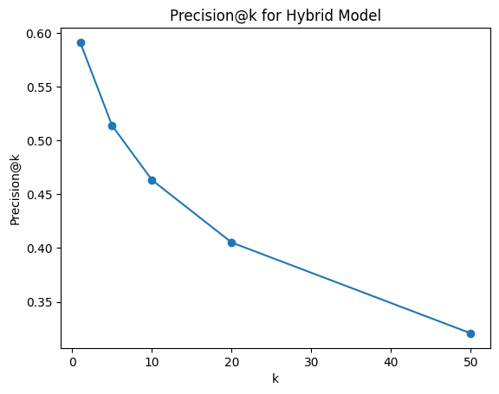
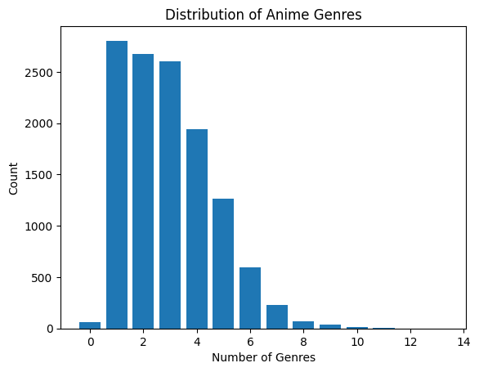
Hybrid Model
This code uses rating and anime datasets, creates a user-item interaction matrix, and creates user features based on anime genres. It trains a hybrid model using the LightFM library, incorporating user features. A function is defined to generate recommendations for a specific user. The code combines collaborative filtering and content-based filtering to provide personalized recommendations for anime users.

Slide 14
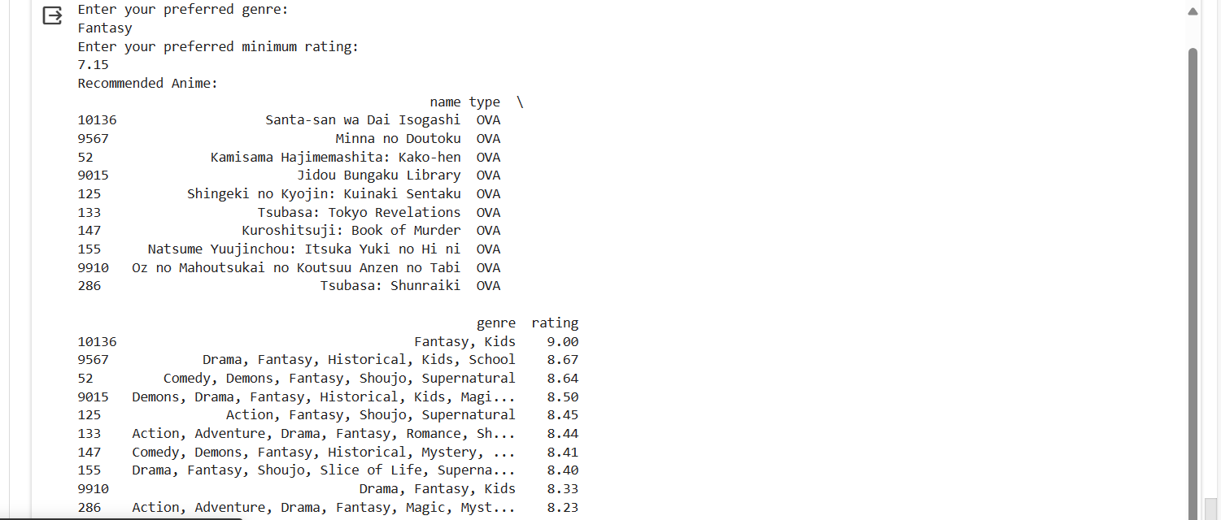
Knowledge-Based Recommendations
The knowledge-based recommendation model is a method that uses a dataset to generate top recommendations based on user preferences. The model uses the anime dataset, which contains information about different anime genres, genres, and ratings. The recommendation function is defined using the anime dataset and user preferences, which are then filtered based on the user's preferences. The resulting anime are sorted based on their ratings in descending order, with the highest-rated anime at the top.

Slide 15
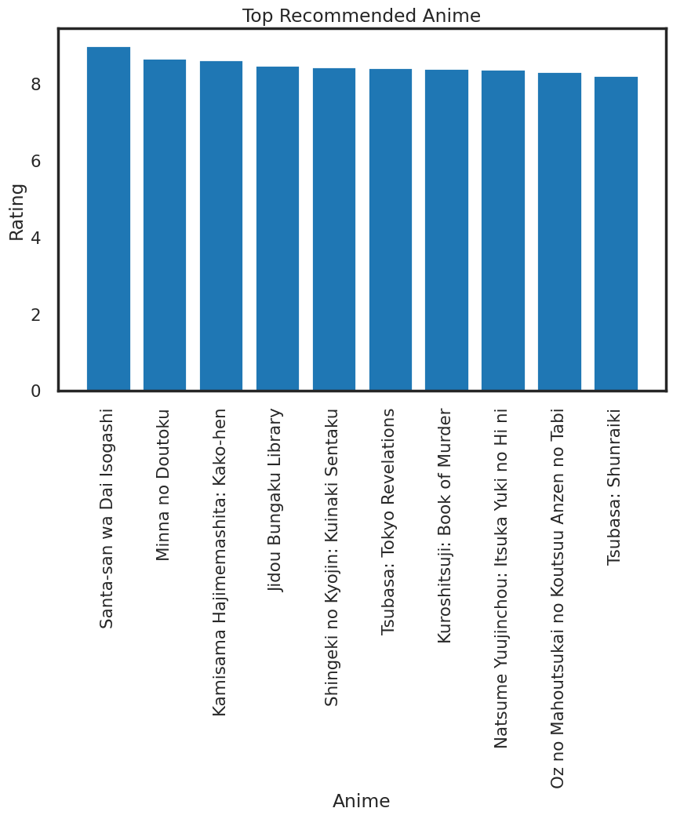
The model relies on filtering the dataset based on user preferences and providing top recommendations. It does not use collaborative filtering or user behavior data, but focuses on matching the user's preferred criteria to the animation attributes in the dataset. The user's favorite anime characteristics are entered, and the knowledge_based_recommendations function is called using their preferences. The resulting recommendations are stored in the recommendations variable, and the top 10 recommended anime are displayed. If no recommendations are found, a message is displayed.
Customizations can be made based on the dataset structure and specific requirements, as well as incorporating more complex rules or additional criteria based on domain knowledge.

Slide 16
Conclusion
The recommendation system for anime is designed to help users find animation based on their interests. It can be used for new users without anime display dates or those with existing display dates. The system uses a content-based filter to help users choose anime based on similar plots or types. The "Anireco" animation recommendation system aims to find works that align with individual preferences and identify expanding relevant content. The system's network scheme submission method has been proven to reduce exploration and lead to new business detection. It can also provide recommendations based on user preferences and business frequency. The system has been found to be effective in identifying and recommending anime works.

Slide 17
References
1. Nuurshadieq and A. T. Wibowo, "Leveraging Side Information to Anime Recommender System using Deep learning," 2020 3rd International Seminar on Research of Information Technology and Intelligent Systems (ISRITI), Yogyakarta, Indonesia, 2020, pp. 62-67, doi: 10.1109/ISRITI51436.2020.9315363.
2. S. Ota, H. Kawata, M. Muta, S. Masuko, and J. Hoshino, "AniReco: Japanese Anime Recommendation System," in Entertainment Computing – ICEC 2017, N. Munekata, I. Kunita, and J. Hoshino, Eds. Cham: Springer, 2017, vol. 10507. https://doi.org/10.1007/978-3-319-66715-7_49.
3. F. Ricci, L. Rokach, and B. Shapira, "Introduction to Recommender Systems Handbook," in Recommender Systems Handbook, F. Ricci, L. Rokach, B. Shapira, and P. Kantor, Eds. Boston, MA: Springer, 2011. https://doi.org/10.1007/978-0-387-85820-3_1.

